Slide 1

LAND SELLING THROUGH APP
FASAL RAHMAN
MES24MCA-2014
Department of Computer Applications
MES College of Engineering, Kuttippuram
20-08-2025

Slide 2
PRODUCT OWNER Dr. GEEVAR C ZACHARIAS Assistant Professor DEPARTMENT OF COMPUTER APPLICATIONS MES COLLEGE OF ENGINEERING, KUTTIPPURAM

Slide 3
TABLE OF CONTENTS
Introduction
Objective
Existing System
Proposed System
Motivation
Functionalities
Module Description
Developing Environment
Sprint Backlog
Product Backlog
User Story
Project Plans
Data Flow Diagrams
ER Diagram

Slide 4
LAND SELLING THROUGH APP
Web-based platform to streamline land selling and buying.
Eliminates intermediaries, delays, and lack of transparency.
Built using Django backend and HTML/CSS/Bootstrap frontend.
Centralized system for verified users to list, browse, and connect.
Secure storage using SQLite

Slide 5
OBJECTIVES
Provide centralized, secure platform for land transactions.
Ensure transparency between buyers and sellers.
Enable easy land listing with complete details.
Support advanced search and filtering options.
Include admin dashboard for verification and control.

Slide 6
EXISTING SYSTEM
Manual land selling process with paperwork.
Dependence on brokers and middlemen.
Delayed communication between buyers and sellers.
Lack of trust and verification mechanisms.
No centralized online system for land listings.

Slide 7
PROPOSED SYSTEM
Digital platform accessible via web application.
User authentication and profile verification.
Direct interaction between landowners and buyers.
Structured data and document storage.
Faster and more transparent transactions.

Slide 8
MOTIVATIONS
Increasing need for digitization of real estate services.
Demand for trustworthy and efficient platform.
Eliminate fraud, misinformation, and delays.
Promote digital adoption in rural and urban markets.

Slide 9
FUNCTIONALITIES
User Registration & Login – Secure sign-up and authentication.
Land Listing – Add photos, location, price, and documents.
Search & Filter – Find properties quickly.
In-App Messaging – Direct user communication.
Admin Dashboard – Approve and verify listings.
Document Upload & Verification – Ensure transparency.

Slide 10
MODULE DESCRIPTION
User Module –
Handles registration and login.
Allows users to create and manage land listings.
Enables searching and filtering of available properties.
Provides in-app messaging to communicate with potential buyers/sellers.

Slide 11
MODULE DESCRIPTION
Admin Module –
Manages verification of users and property listings.
Controls content approval and listing visibility.
Oversees secure storage of user data and documents.
Provides dashboard for monitoring system activities.

Slide 12
DEVELOPING ENVIRONMENT
Operating System: Windows
Backend Framework: Django (Python)
Frontend: HTML, CSS, Bootstrap
Database: SQLite (development)
IDE: VS Code
Version Control: Git / GitHub

Slide 13
SPRINT BACKLOG
Backlog tem | Status And Completion Date | Original Estimation in Hours | Day 1 hrs | Day 2 hrs | Day 3 hrs | Day 4 hrs | Day 5 hrs | Day 6 hrs | Day 7 hrs | Day 8 hrs | Day 9 hrs | Day 10 hrs
SPRINT1
Project setup (Django + config) | 22/08/2025 | 5 | 2 | 2 | 1 | 0 | 0 | 0 | 0 | 0 | 0 | 0
Basic homepage + routing | 24/08/2025 | 4 | 1 | 1 | 1 | 1 | 0 | 0 | 0 | 0 | 0 | 0
SPRINT 2
User authentication (login/signup) | 28/08/2025 | 6 | 2 | 2 | 2 | 0 | 0 | 0 | 0 | 0 | 0 | 0
User profile dashboard | 30/08/2025 | 5 | 1 | 1 | 1 | 1 | 1 | 0 | 0 | 0 | 0 | 0

Slide 14
SPRINT BACKLOG
Backlog Item | Status And Completion Date | Original Estimation in Hours | Day 1 hrs | Day 2 hrs | Day 3 hrs | Day 4 hrs | Day 5 hrs | Day 6 hrs | Day 7 hrs | Day 8 hrs | Day 9 hrs | Day 10 hrs
SPRINT3
Land listing module (CRUD operation) | 03/09/2025 | 7 | 2 | 2 | 2 | 1 | 0 | 0 | 0 | 0 | 0 | 0
Search and filters functionality | 06/09/2025 | 5 | 2 | 2 | 1 | 0 | 0 | 0 | 0 | 0 | 0 | 0
SPRINT 4
Inquiry/contact module | 10/09/2025 | 6 | 2 | 2 | 2 | 0 | 0 | 0 | 0 | 0 | 0 | 0
UI improvement and testing | 15/09/2025 | 7 | 2 | 2 | 1 | 1 | 1 | 0 | 0 | 0 | 0 | 0
TOTAL |  | 47 | 14 | 14 | 12 | 4 | 2 | 1 | 0 | 0 | 0 | 0
The table given above is for reference only. Update/create a table with your data.

Slide 15
PRODUCT BACKLOG
ID | NAME | PRIORITY <high/medium/low> | ESTIMATE (Hours) | STATUS <Planned/In progress/Completed>
1 | PROJECT SETUP | Medium | 5 | PLANNED
2 | HOMEPAGE DESIGN + ROUTING | Medium | 4 | PLANNED
3 | USER AUTHENTICATION (Login/Signup) | High | 6 | PLANNED
4 | USER DASHBOARD PROFILE | High | 5 | PLANNED
5 | LAND LISTING MODULE (CRUD) | High | 7 | PLANNED
6 | SEARCH AND FILTER | High | 5 | PLANNED
7 | INQUIRY/CONTACT MODULE | Medium | 6 | PLANNED
8 | UI IMPROVEMENTS + TESTING + DEPLOYMENT | High | 7 | PLANNED

Slide 16
USER STORY
User Story ID | As a type of User | I want to <Perform some task> | So that i can <Achieve Some Goal>
1 | ADMIN | Login | Access and manage all land listing and user data securely
2 | ADMIN | Approve or reject land listing | Ensure only verified lands are displayed to buyers
3 | ADMIN | Manage users(Add/Block) | Maintain platform integrity and security
4 | SELLER | Register and login | Post land details for sale security
5 | SELLER | Add / Update / Delete and listing | Keep my land information accurate and up to date
6 | BUYER | Search and filter lands | Easily find suitable land by location,size,and price
7 | BUYER | View land details | Get complete information before contacting seller
8 | BUYER | Contact seller | Directly communicate to negotiate and proceed with purchase

Slide 17
PROJECT PLAN
User StoryID | Task Name | Start Date | End Date | Days | Status
1 | Sprint 1 | 22/08/2025 | 25/08/2025 | 7 | Planned
2 |  | 24/08/2025 | 28/08/2025 |  | Planned
3 | Sprint 2 | 28/08/2025 | 31/08/2025 | 8 | Planned
4 |  | 30/08/2025 | 04/09/2025 |  | Planned

Slide 18
PROJECT PLAN
User StoryID | Task Name | Start Date | End Date | Days | Status
5 | SPRINT 3 | 03/09/2025 | 07/09/2025 | 7 | Planned
6 |  | 06/09/2025 | 09/09/2025 |  | Planned
7 | SPRINT 4 | 10/09/2025 | 13/09/2025 | 8 | Planned
8 |  | 15/09/2025 | 20/09/2025 |  | Planned

Slide 19
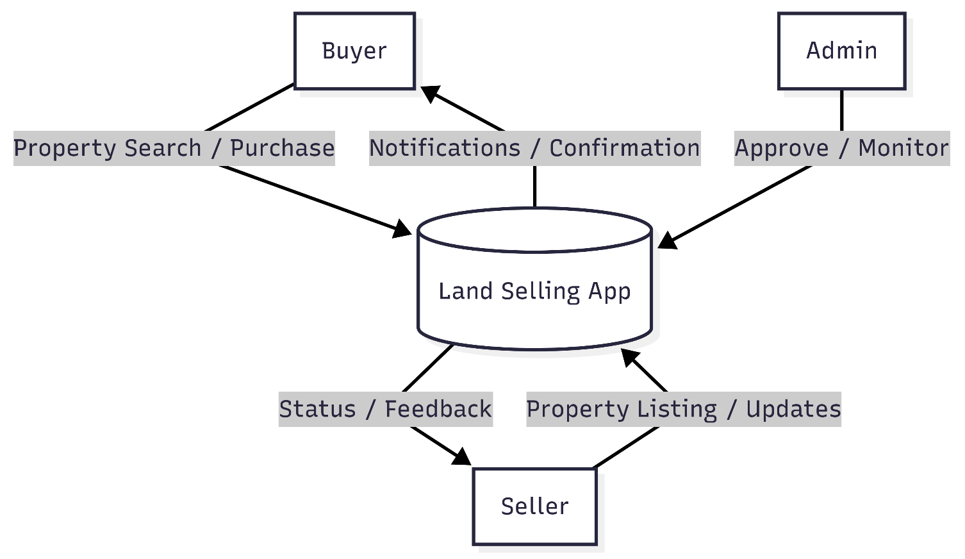
DATA FLOW DIAGRAM
LEVEL 0

Slide 20
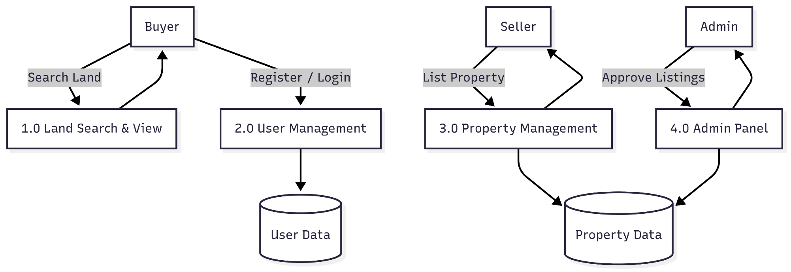
DATA FLOW DIAGRAM
Level 1

Slide 21
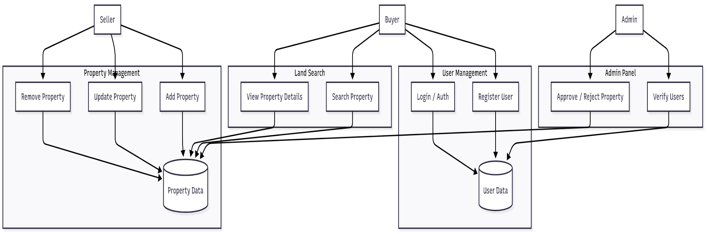
DATA FLOW DIAGRAM
Level 2

Slide 22
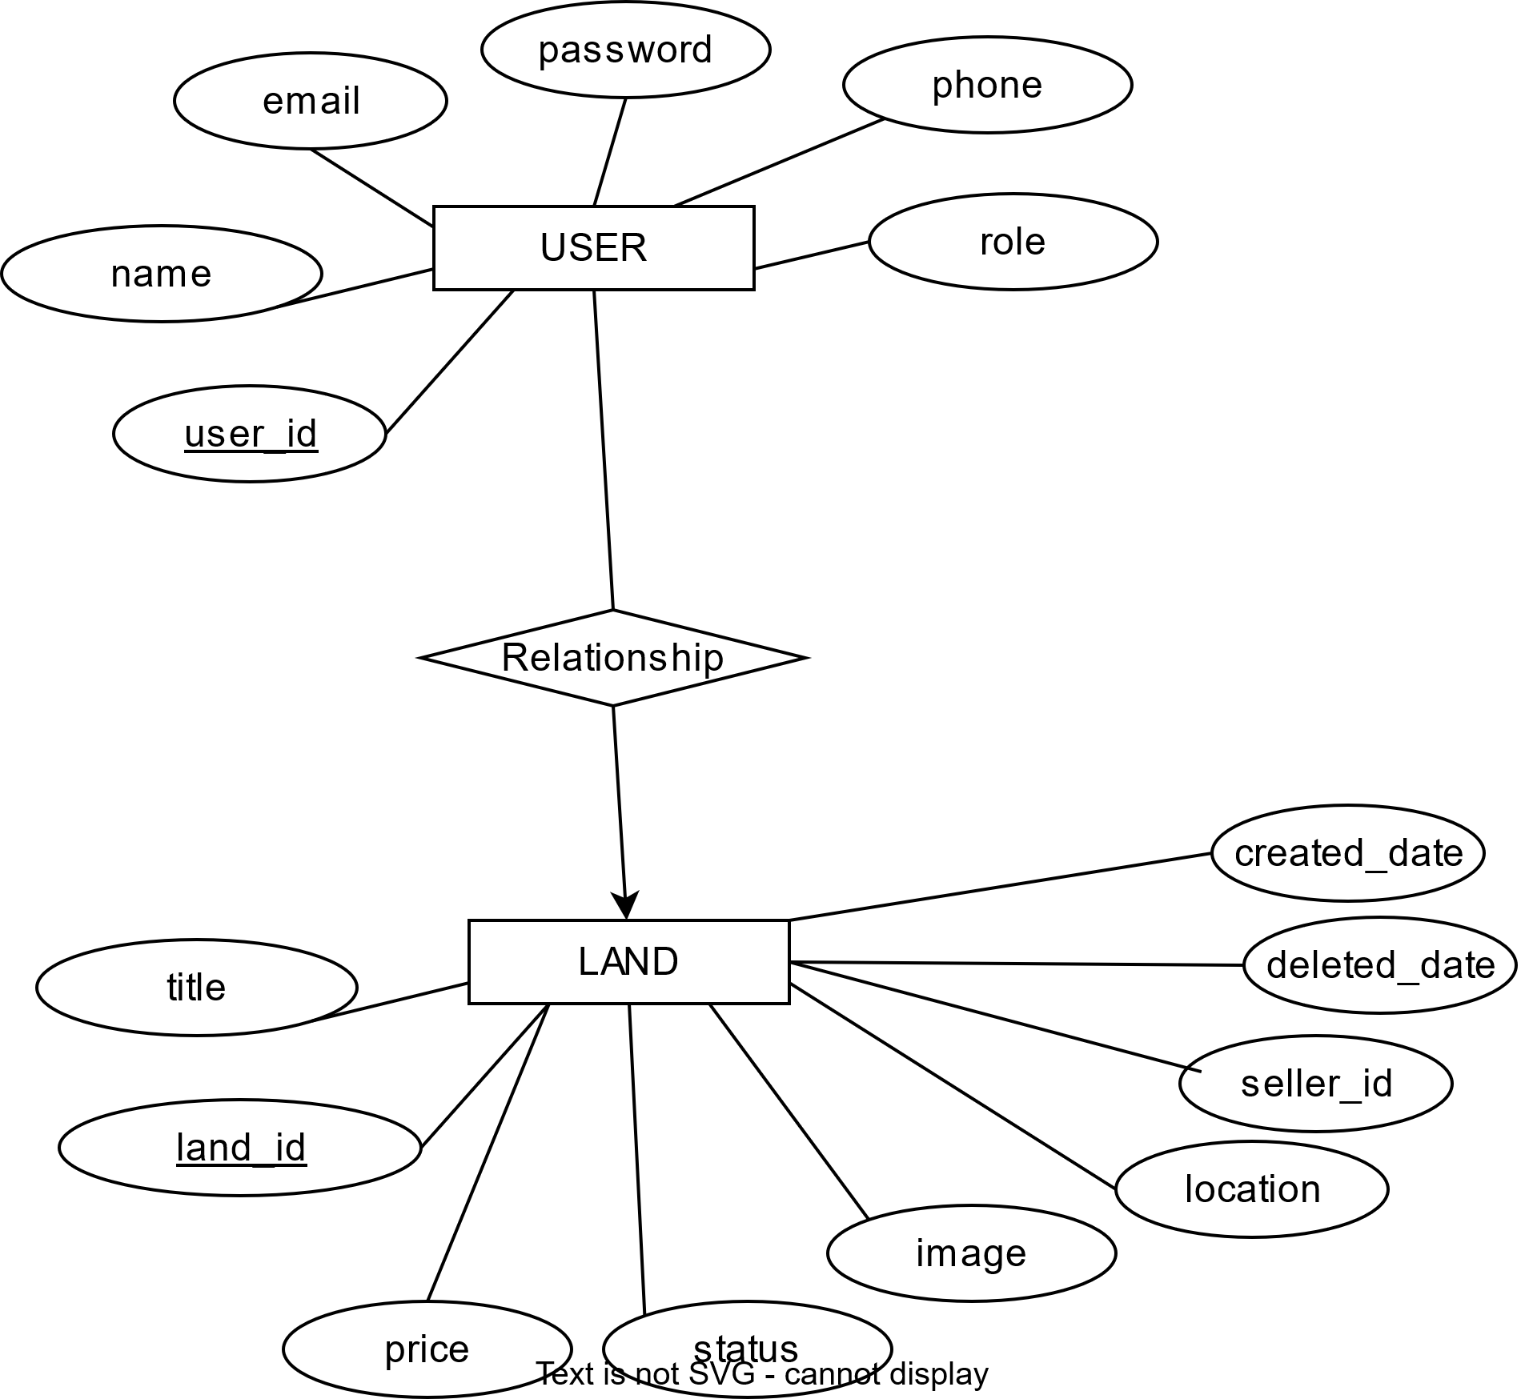
ER DIAGRAM

Slide 23
THANK YOU

